Slide 1

BLOCKCHAIN IN COMMERCIAL REAL ESTATE
Project 3
Dann, Vinay, Anthony, Park & Munir

Slide 2

WHY REAL ESTATE
2

Slide 3


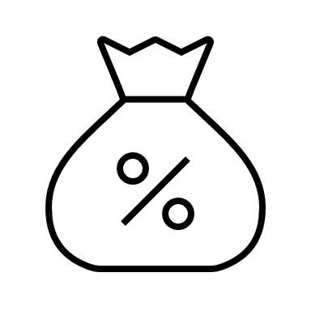
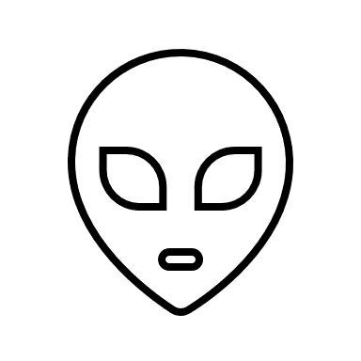

REAL ESTATE ASSET CLASS
A heterogeneous phenomenon with several intermediaries and public services
Biggest asset class that can be tokenized
Global real estate is $280 trillion of which $33 trillion is commercial real estate
3% of the global population invested in commercial real estate
Attractive to millennial cohort as tokenized asset class

Slide 4
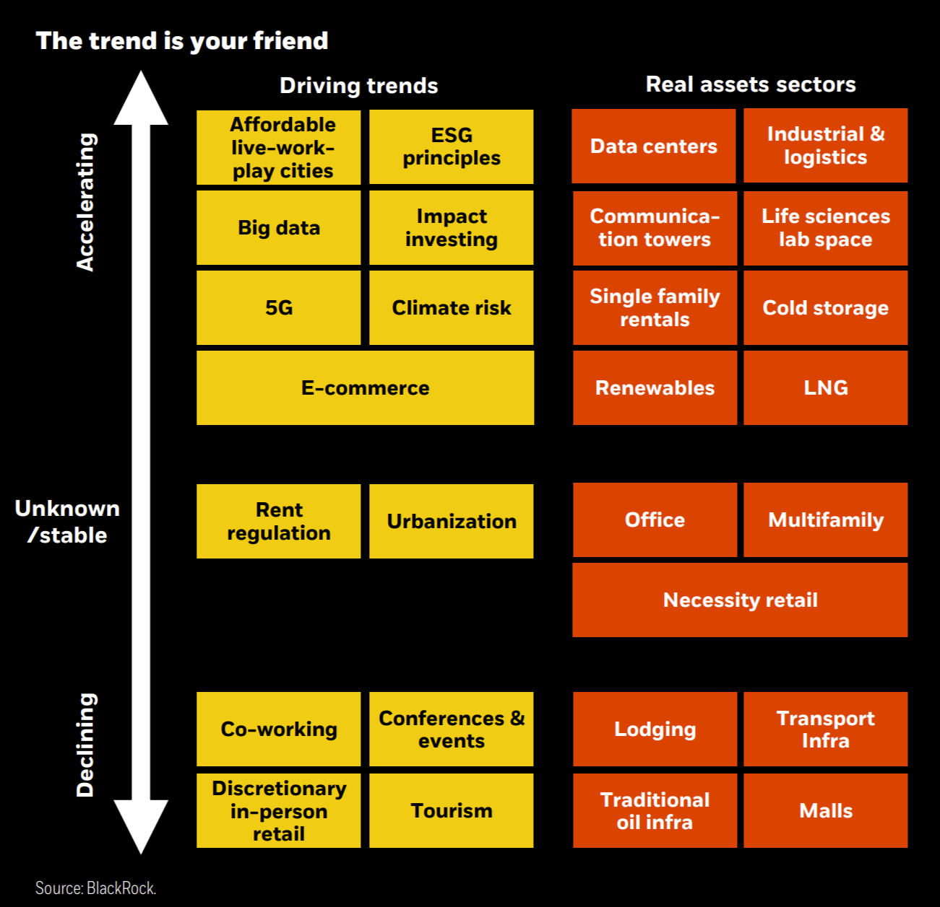
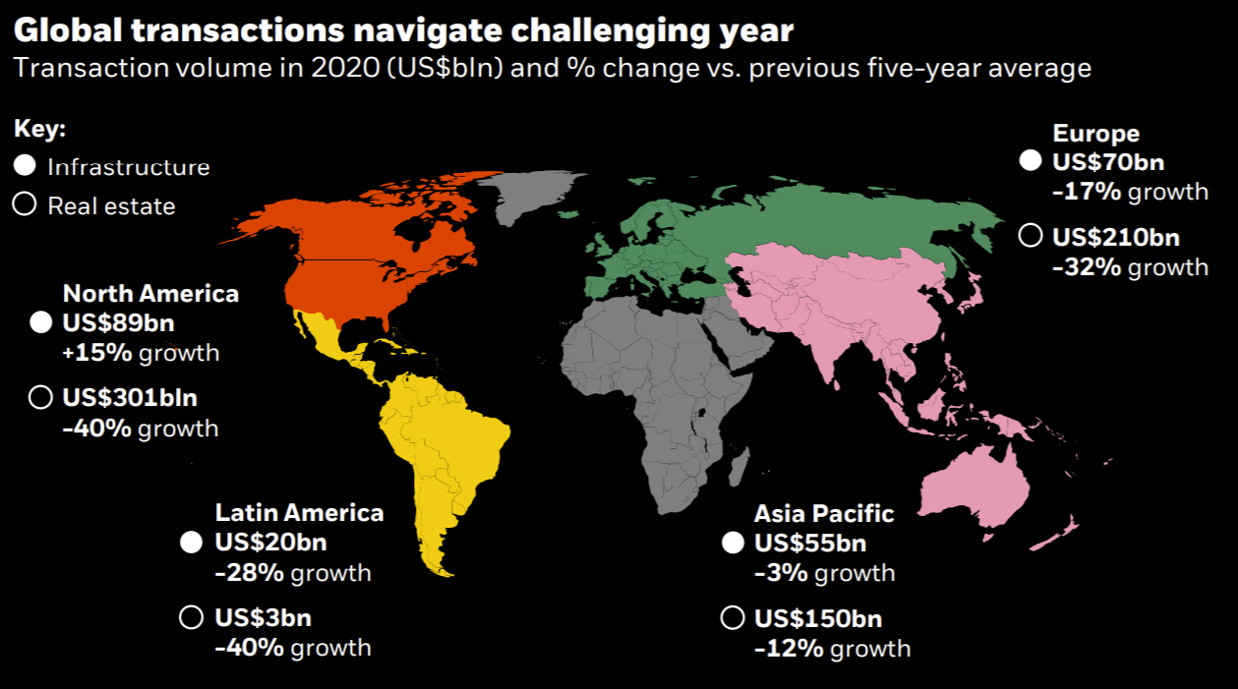
REAL ESTATE ASSET ALLOCATION

Slide 5
PAIN POINTS
5

Slide 6


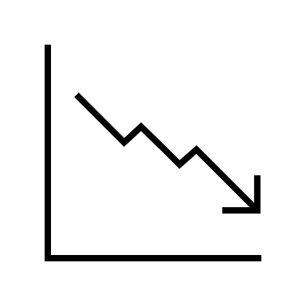


PAIN POINTS IN COMMERCIAL REAL ESTATE
Cumbersome and costly maintenance of investor registry
High minimum tickets for investment
Illiquid asset class with price swings. Isolated secondary market with manual processing
Multiple dislocated and expensive intermediaries
Low levels of transparency

Slide 7
TRANSACTION PROCESS
7

Slide 8
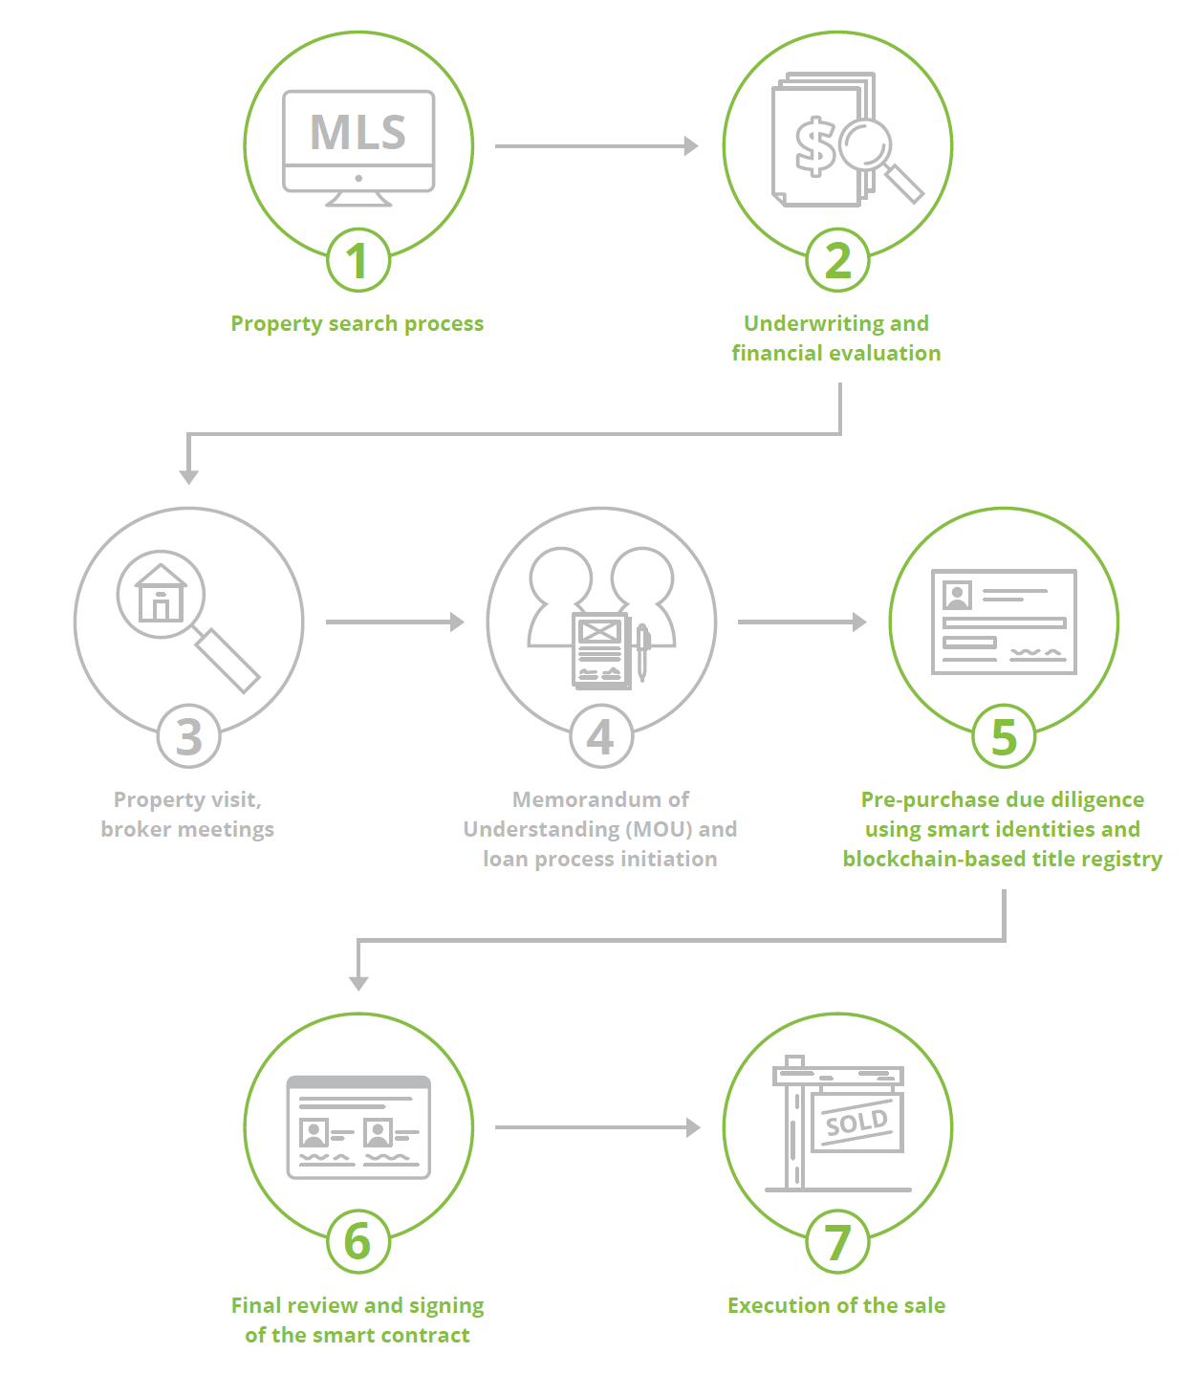
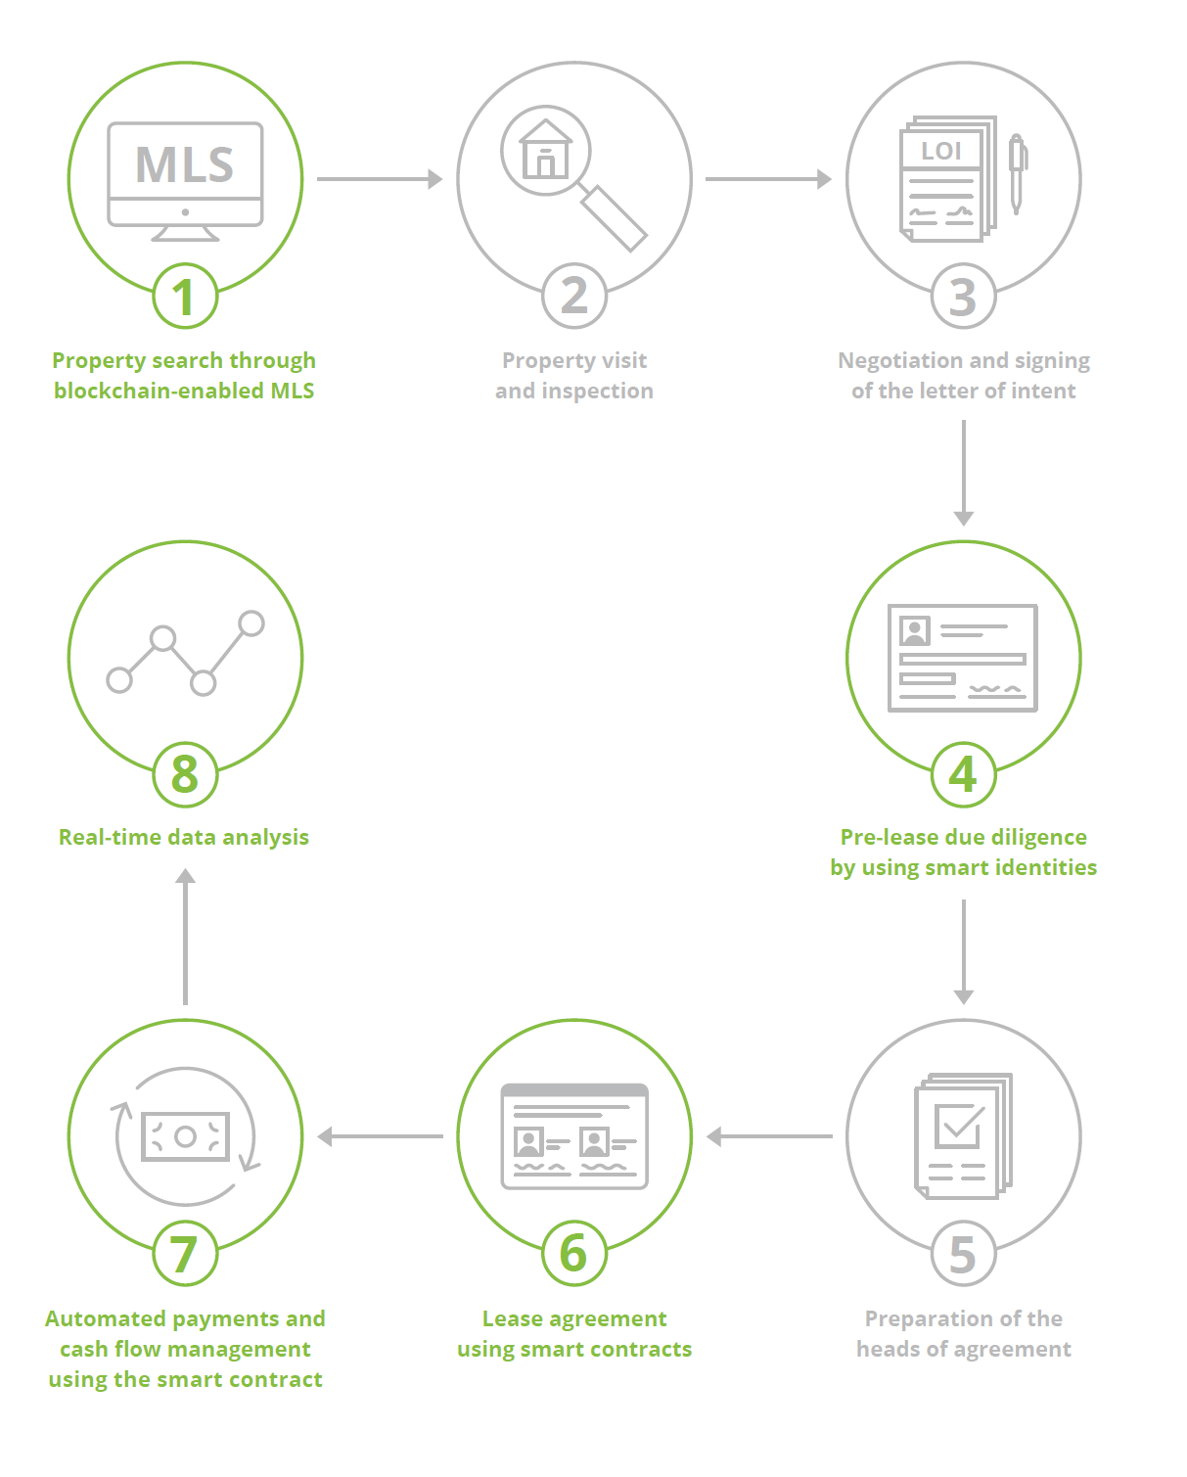
COMMERCIAL REAL ESTATE PROCESS
Sale and Purchase
Lease

Slide 9
THE LANDSCAPE
9

Slide 10


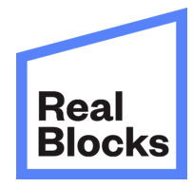


MAJOR COMPANIES USING BLOCKCHAIN IN RE
PropertyClub is a real estate platform that uses blockchain to refine the way people market, search for, buy, sell and invest in properties. Using smart contracts, the company conducts real estate transactions digitally using cryptocurrencies like Bitcoin or its own PropertyClub Coin (PCC)
NYC
ManageGo is leveraging blockchain for rental property owners. The ledger-backed software helps property managers and owners process payments, thoroughly complete credit background checks and manage maintenance ticketing. DLT is helping owners get a more transparent, thorough view of payment history and renter backgrounds.
NYC
RealBlocks uses blockchain to create new avenues for real estate investing. Its platform lets investors buy fractional interest rather than entire portfolios or assets. Through tokenization that's applied using blockchain technology, RealBlocks helps reduce fees, speed up processes and provide liquidity options.
NYC
SMARTRealty uses smart real estate contracts to enact and maintain property purchase and rental agreements. Whether it’s paying rent, establishing mortgages or purchasing a home, the company’s smart contracts help to establish protocols that, if not met, immediately dissolve a contract.
Seattle
Harbor is a compliance platform for tokenizing private securities, including real estate. The company is tokenizing real estate assets, including funds, private REIT’s, building ownership and land in order to increase liquidity and transparency of the market.
San Francisco

Slide 11


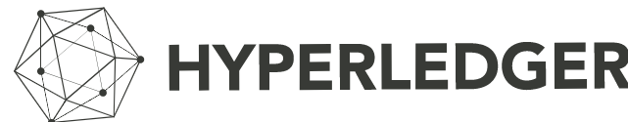


TECHNOLOGY PLATFORMS FOR BLOCKCHAIN
Monax turns contracts into a database of digital agreements to track your commitments in real time
Symbiont is building the next generation of financial markets infrastructure. We are engineers and financial veterans solving finance's toughest challenges in partnership with global financial institutions.
Hyperledger is Hyperledger is an open-source community focused on developing a suite of stable frameworks, tools and libraries for enterprise-grade blockchain deployments
Brickblock was founded at the beginning of 2017, focusing on mapping financial transactions on the blockchain.
Softermii is a software development house focusing on blockchain, crypto-currency exchanges, ICO service packages and Fintech in general.

Slide 12
WHY BLOCKCHAIN
12

Slide 13

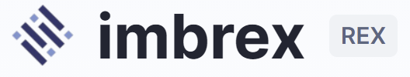

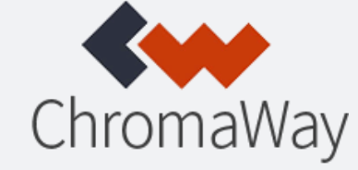
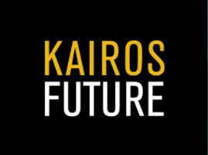


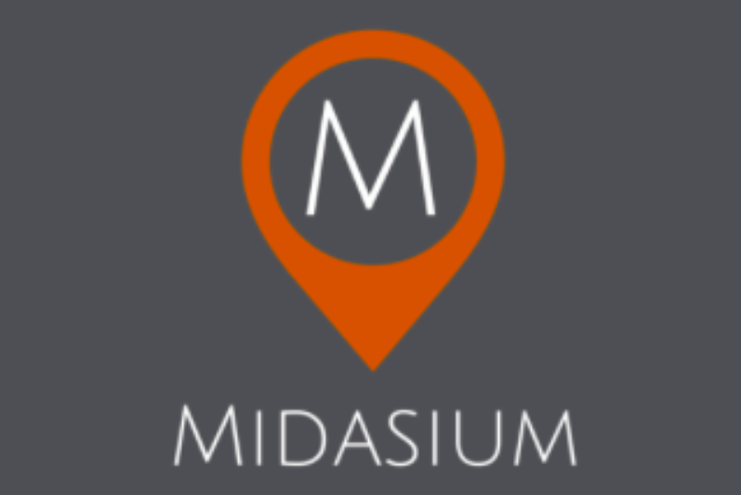

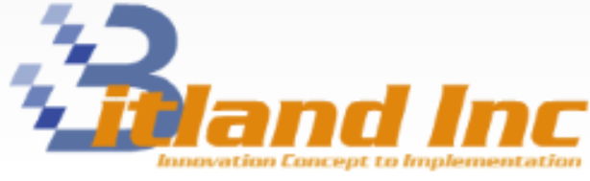
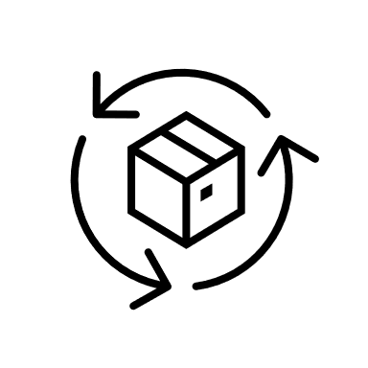



BLOCKCHAIN IN COMMERCIAL REAL ESTATE
A blockchain-based MLS
Due diligence and appraisal through digital identities
Digitized property and cashflow management
Digitized title registration & checks and tokenization
DAPVM
Reduce inefficiencies and increase transparency in financing and payments
Interoperability that refines quality of data, analysis, and decisions

Slide 14
ASSET IDENTIFICATION METHODOLOGY
14

Slide 15
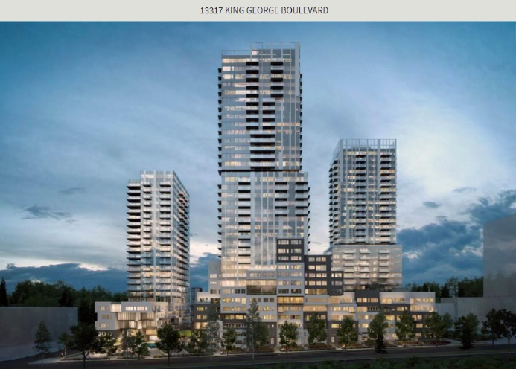
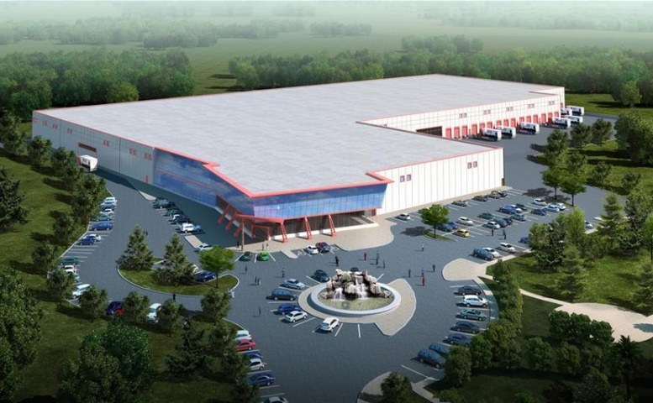
METHODOLGY TO IDENTIFY ASSETS
Location: Metropolis, suburbs of cities with minimum population of 500,000 fr commercial and waterfront for resorts
Value valuation: Target returns comprising of net rental income, cash flow growth and cap rate adjustment providing minimum 15% p.a.
Property Type: Commercial zoning suitable for office, retail and industrial
Overall market conditions: High demand or upcoming localities as per internal and external market research recommendations
Economic environment: Assessment of interest, inflation, insurances, property tax, other cost of holding and managing real estate.
Development phase: Income producing properties from $10 million to $50 million
Description:
Gateway of the Surrey City Centre. ~500m to sky train station. An assembly of 3 properties. Total proposed 946,300 gross sq.ft. buildable, 3 High-rises & 2 low-rises. 3rd reading approved
Description:
Exciting new industrial subdivision in east London. Quick access to Hwy 401. Build-to-suit opportunities of 50,000 SF up to 1.5 M SF available. Zoned GI1 and L2 allowing for most industrial and warehouse uses.
Address: 13317 KING GEORGE BOULEVARD, Surrey, British Columbia V3T2T5
Value: $35,855,307
Land Size: 82942 sqft.
Address: 2180 SCANLAN Street Unit# C, London, Ontario N5W6G7
Value: $46,250,000
Exterior building Size: 250,000 sqft Land Size: 55.57 acre

Slide 16
TOKENIZATION
16

Slide 17

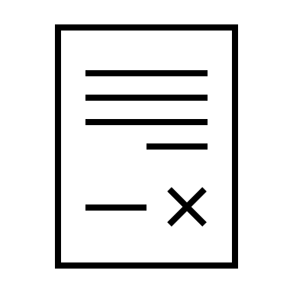

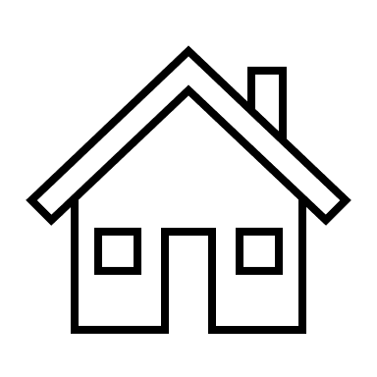
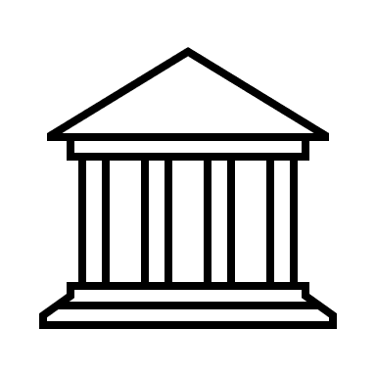
TOKENIZATION PROCESS
Token issuance instructions through proprietary platform dashboard
Tokens issued
Token contract created
Bank transfer
Seller
Smart contract
Proprietary platform / certified partners
Investors
Title
Bank/ Insurance company
Commercial real estate
Mortgage
Investor Protection through bank and insurance company
Bank transfer & Escrow contract

Slide 18
TOKEN PURCHASE PROCESS
Transaction completed. Tokens can be traded in
Secondary market
Token holder receive distribution and voting rights from asset
Investor can chose to hold tokens or sell in secondary market or our marketplace
Investment Disclosure
Investor
KYC
Pre-application
Accredited Investor
Added to whitelist & tokens purchased
Funds are kept in escrow
Money released to investors if funding goal not met

Slide 19
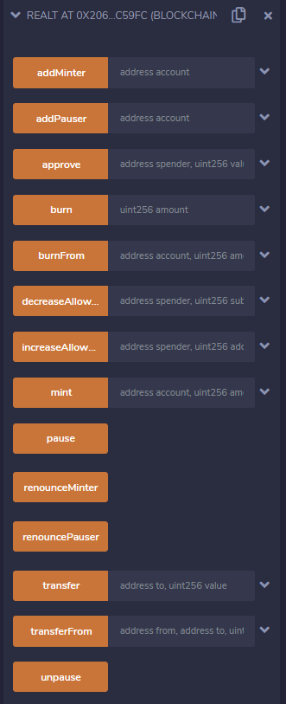
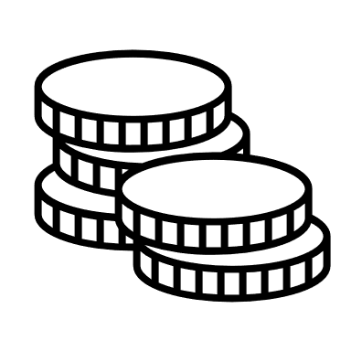
TOKENIZATION PROCESS DETAILS
Smart Contracts works in Ethereum blockchain that automatically implements and enforces agreements between users.
Contracts are built on ERC20 Standard (Minting & Burning token, Capped & Timed crowd sale)
Purchase of rents Stable coin so that periodic appraisal in the value of the property to that of each token would be consistent
Maximum & Minimum cap would be defined for each of the assets to be tokenized per wallet/ investor
Any investors who are interested to participate in the offering would require to disclose wallet address and personnel details through whitelist smart contract
Token holder would be having voting rights if the property has achieved it targeted sales value

Slide 20
LIMITATIONS
20

Slide 21




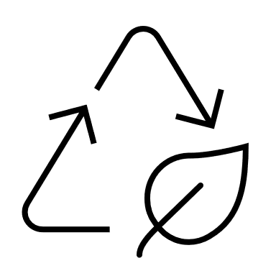

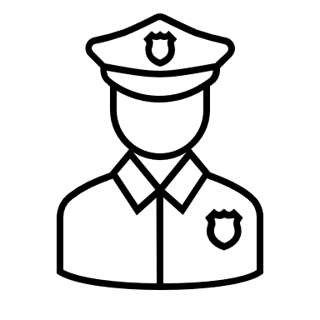

LEGAL AND TECHNOLOGY LIMITATIONS OF BLOCKCHAIN
Smart contracts not be able to address complex issues i.e. force majeure
Land registry in many countries is not digitized
Data protection jurisdictions and cross-border data transfer compliance
Cyber security and reputational damage
Legal ecosystem in yet ready to cater to blockchain
Litigation & dispute resolution – centralised or decentralised?
Securities regulations are evolving in many jurisdictions
Tax & reporting, corporate codes, KYC/AML, international investors

Slide 22
GOING FORWARD
22

Slide 23

PROJECT GOING FORWARD
To create a user experience that is streamlined and easy for the everyday user is a challenge that all blockchain-based solution required (Secondary market)
Gas price transaction on Ethereum blockchain is high. Alternative blockchain which utilize less to no gas fee, less latency and more customize feature (Neo Blockchain)
Inter-operability with legacy banking system
Use Machine learning for properties selection, valuation & risk management
Explore opportunities international market

Slide 24
THANK YOU
Insert Image

